Slide 1
Battle of Neighborhoods
Madrid

Slide 2
Opening a new Restaurant :
An area where potential clients are tourists but also locals
The area has good transport connection: underground stations, parking.
Busy area where the value added of his restaurant could make an impact “borrowing” customers from restaurants around.
Madrid:
More than 6 million tourists per year.
Metropolitan area with approximately 6.5 million inhabitants.

Slide 3
Data acquisition and Metodology:
City coordiantes: City Council of Madrid at their website datos.madrid.es. Data cleaning with Geopandas and Geocoding API (Google). Data contains 21 boroughs and 131 neighborhood
Using Foursquare API to get venue data
Clustering using K-means algorithm for data segmentation

Slide 4
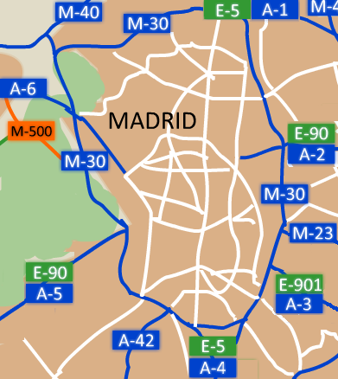
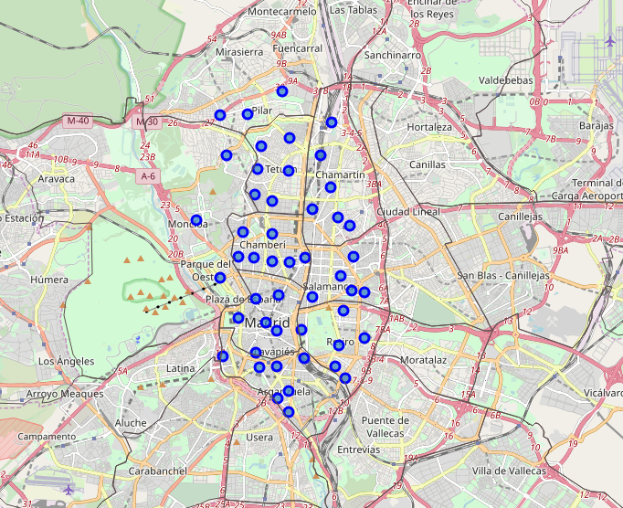
Area of study:
Madrid Central: 9 boroughs and 49 neighborhoods.

Slide 5
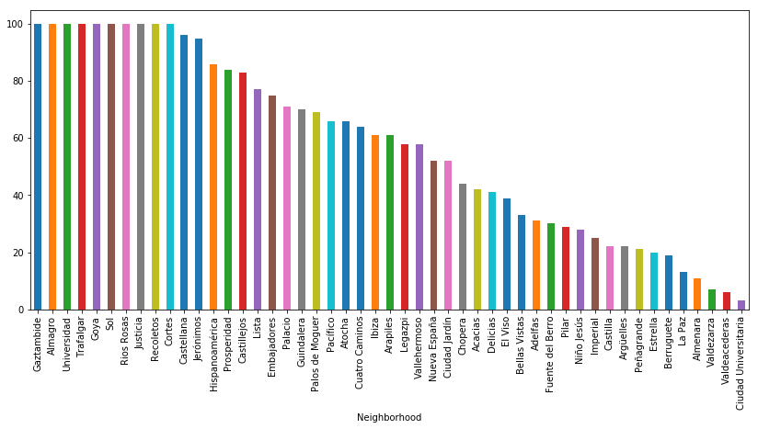
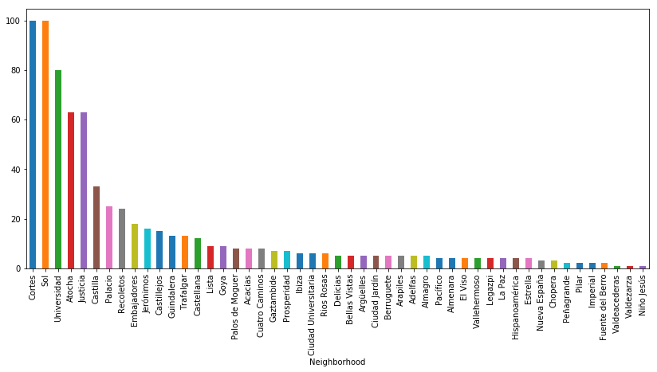
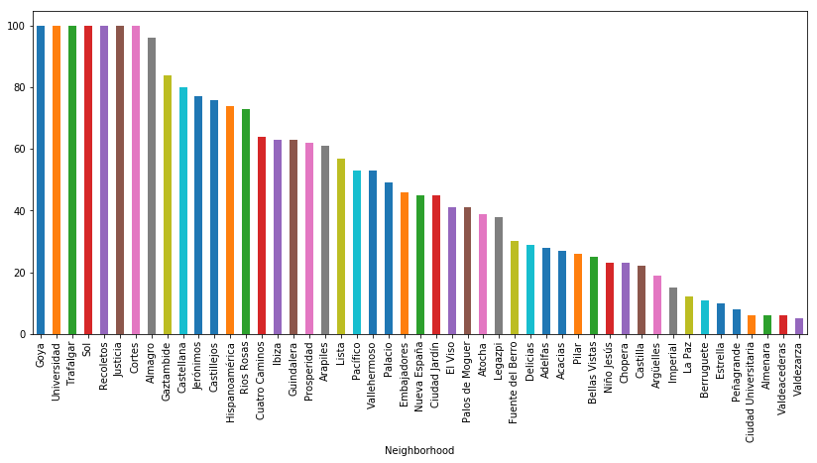
Total Venues:
2830
Travel & Transport:
738
Food:
2411

Slide 6


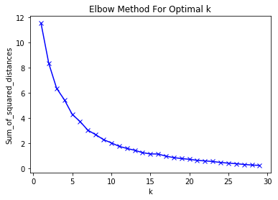
K-Means optimization
All venues: K = 11
Food: K = 11
Travel and Transport: K = 6

Slide 7
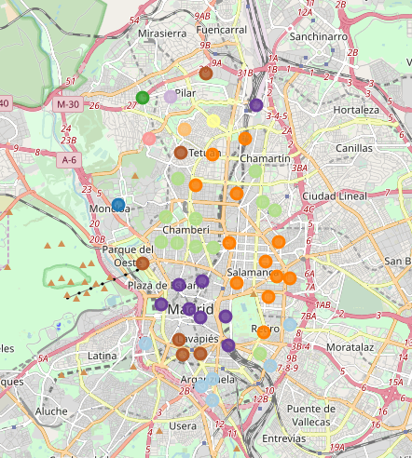
Clustering: All venues
All Venues
Cluster 3 (ligh green): Spanish Restaurants and Tapas, with bars and cafes
Cluster 7 (orange): More variaty of restaurants, more expensive area
Cluster 9 (violet): Tourist area with Hotels, museums and also Spanish Restaurants and

Slide 8
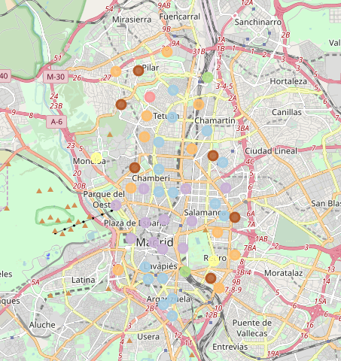
Clustering: Travel and Transport
Travel and Transport Venues:
Cluster 1 (light blue): Transport links and hotels
Cluster 5 (light violet): Tourist area: Hotels, bed and breakfasts and good transport links.

Slide 9
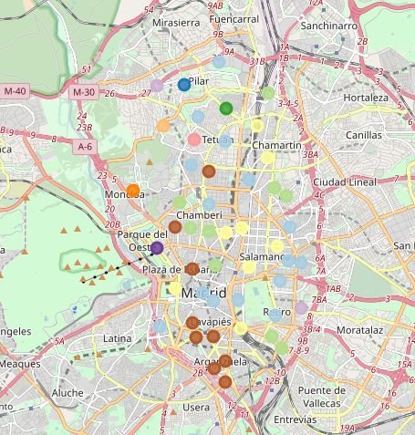
Clustering: Food
Food venues:
Cluster 0 (brown): Middle class area with a lot of tapas restaurants
Cluster 1 (light blue): Area with lots of restaurants and cafes.
Cluster 3 (green): Cafes and restaurants
Cluster 10 (yellow): More expensive restaurants and big variety

Slide 10
Conclusion
Areas to open the a new Restaurant in Madrid:
Area of Sol and Cortes, is a tourist area with:
Plenty of accommodation: Hotels and Bed & Breakfast
Places to visit: Museums, squares, city tours
Spanish Restaurants and Tapas Bars.
Area of Castellana, Lista and Recoletos: well known area with plenty of shops and more expensive restaurants. All type of food:
Seafood
Japanese
Italian
Argentinian
also Spanish restaurants.

